Slide 1


Designing for AAC Users
Miguel Castillo
Notes:
In this session, I’ll be presenting on Designing for AAC Users. My interest in this topic stems from conversations I often have with my partner, who is a Speech-Language Pathologist.
Through these conversations, I’ve come to understand how important—and even life-changing—AAC devices are for communication. However, I’ve also learned how challenging it can be to learn and accept these devices, not only for the primary users but also for those around them. Many of these challenges stem from the devices themselves, particularly the software. Since AAC devices are not widely mainstream, there has been limited effort to improve the user experience. Existing systems present many opportunities for enhancement.
A major contributing factor to this issue is the lack of involvement of actual AAC users in the development process. As highlighted in many presentations, engaging the people you are designing for is a fundamental principle of user-centered design.
I came across a couple of articles on this topic that I’d like to share. These articles explore ways to involve AAC users in the research stage, helping to ensure that their needs and experiences shape the design process, ultimately building a better system.

Slide 2
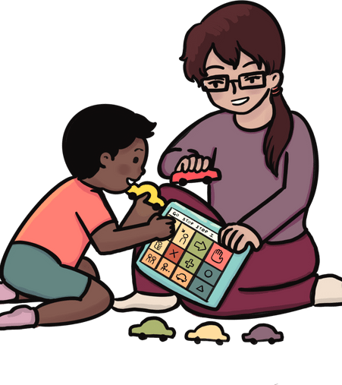
What’s AAC?
AAC = Augmentative and Alternative Communication
Augmentative = add to or supplement speech
Alternative = different from speech
Communication devices, systems, strategies and tools that replace or support spoken language.
These tools help a person communicate, when they cannot rely on speech.
Notes:
AAC stands for Augmentative and Alternative Communication
Augmentative = add to or supplement speech
Alternative = different from speech
AAC are communication devices, systems, strategies and tools that replace or support spoken language.
These tools help a person communicate, when they cannot rely on speech.

Slide 3
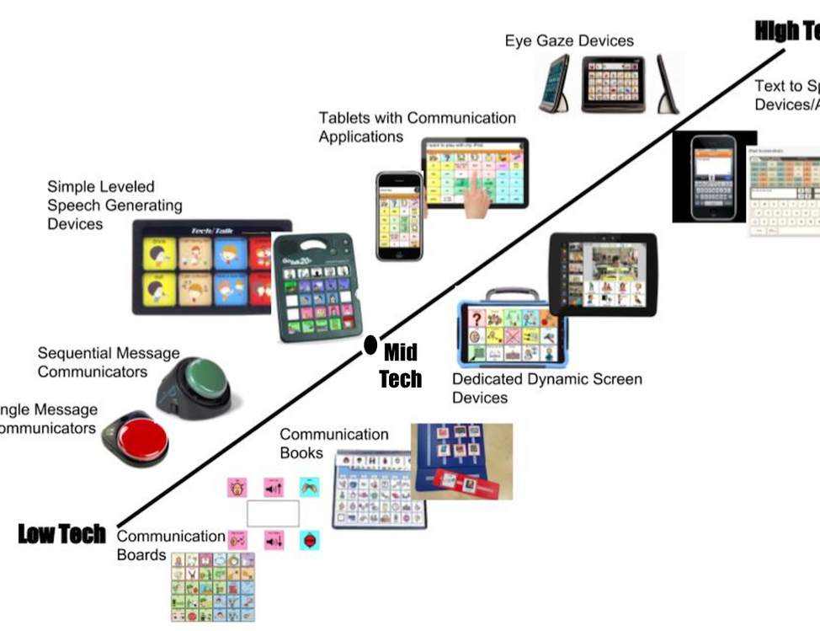
AAC Examples
Non Tech
Low Tech
High Tech
Notes:
Here are some examples of AAC devices.
AAC can be aided or unaided meaning the person can either use their body (unaided) to communicate or external tools (aided) like paper (low tech) or an iPad (high tech – speech generating device).
Non-tech to low tech
gestures and facial expressions
writing/drawing
spelling words by pointing to letters
using single pictures or visual sentences
High-tech
using a communication app on an iPad or tablet
Using a keyboard (real or virtual) to type in messages to request, comment and/or share thoughts and ideas.
Depending on the user’s profile needs (physical, linguistic, cognitive, contextual) a language system and tool can be recommended by an AAC Specialist.

Slide 4
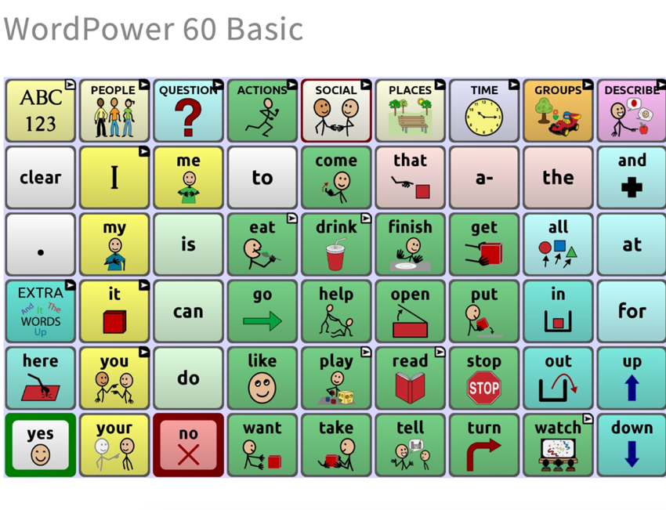
AAC Examples
Non Tech
Low Tech
High Tech
Notes:
For this presentation, I will be focusing on High tech.
Here I have TouchChat WordPower 60 Basic’s main screen layout, which is a language system available on the TouchChat Discover iOS application. This language system is composed of core and fringe vocabulary designed to aid early language learners with difficulties communicating using speech and/or have expressive language disorders. This language system is composed of words, symbols, and pictures. It is designed this way as users may not yet read or spell.
This system allows for users to interact with it via touch, headtracking, and switch scanning.
This is commonly used on iPads.

Slide 5

Who are the users?
Primary users
Child or person
Autism
Down syndrome
Cerebral Palsy
Apraxia & dyspraxia
Secondary users
Parent or guardian
Speech language pathologist
Teachers, aids, friends, family
Notes:
So, who are the users.
This can be a child or person whose speech is not developing within the realm of what is considered typical or is not likely to develop normal speech due to Autism, Down Syndrome, Cerebral Palsy. AAC can be used for persons who have Aphasia, Traumatic Brain Injury, Multiple Sclerosis or other progressive diseases such as ALS which would affect their communication.
In some cases, these systems, particularly early language focused systems, required the ongoing assistance of communication partners to ensure the device is being used and language goals are being met. These encompass parents, family members, teachers, peers, and service providers (SLP, AAC specialist). AAC specialist evaluate and work with the users by training them on the AAC devices and setting their language goals.
Overall, AAC has been shown to enhance a child or person’s ability to communicate and have better functional interactions with others.

Slide 6

Challenges Surrounding AAC Implementation
Difficult to learn and use
Requires a lot of training
Portability issues
Technological problems
Social stigma
Language limitations
Notes:
Difficult Learning Curve: AAC systems can be challenging to learn and use, not only for the primary user but also for caregivers, educators, and family members. Many secondary users receive inadequate training, leading to frustration and eventual abandonment of the device.
This challenge is especially significant for early language learners who have difficulty communicating through speech or have expressive language disorders. They require ongoing support from communication partners to ensure the device is used effectively and that their language development goals are met.
Portability Issues: Some AAC devices are bulky and inconvenient to carry, limiting their practicality in daily life.
Technological Barriers: Frequent technical issues, such as software glitches, battery life concerns, or device malfunctions, can disrupt communication.
Social Stigma and Limited Opportunities: AAC use can draw attention to a person’s disability rather than their abilities, reinforcing stereotypes and creating social barriers.
Language Limitations: Many AAC systems primarily support English, making them less accessible for users who communicate in other languages.

Slide 7

User Centered Design
UCD
An iterative design process in which designers focus on the users and their needs in each phase of the design process. In UCD, design teams involve users throughout the design process via a variety of research and design techniques, to create highly usable and accessible products for them.
AAC users are frequently excluded from design process
Resulting in systems that are difficult to use, or do not meet the necessary needs
Qualitative research methods assume participants can easily communicate verbally
Notes:
As covered in the other presentations
UCD
An iterative design process in which designers focus on the users and their needs in each phase of the design process. In UCD, design teams involve users throughout the design process via a variety of research and design techniques, to create highly usable and accessible products for them.
Participatory design
Contextual design
However, AAC users are frequently excluded from the design process, resulting in systems that are difficult to use or fail to meet their needs. One critical area where users are often excluded is the research process, particularly in qualitative research. This is because qualitative methods, such as interviews or focus groups, typically assume that participants can communicate verbally.
This creates a challenge for researchers who may feel uncertain about the best practices for including AAC users in their studies.

Slide 8

Best Practices for Conducting Qualitative Interviews With AAC Users
Interviews
Considerations
Fatigue
Responses may be shorter and take longer to produce
Suggestions
Ask the participants about their accessibility needs
Provide options
Asynchronous or synchronous interview sessions
Provide interview questions ahead of time
Provide ample time
Provide single response answer, were possible
Involve communication partner
Member checking
Notes:
Here are the best practices for conducting qualitative interviews with AAC users:
Interviews – Considerations
Fatigue
- Depending on the AAC system a participant uses, repetitive movements—such as eye gazing—can be physically demanding. Conversely, some AAC users may have little to no movement, particularly during interviews where they remain seated for extended periods. Holding a single position for a long time while accessing a device can be tiring.
Response Time and Length
- Responses may be shorter and take longer to produce. Many AAC systems require selecting words through eye-tracking, switch scanning, or touchscreen input, all of which take longer than speech.
- Some users have limited dexterity, making navigation and selection slower.
- Each word or phrase must be consciously selected, requiring additional cognitive effort.
Despite these challenges, responses from AAC users are equally valid and valuable.
Interviews - Suggestions
Ask Participants About Their Accessibility Needs
- Since AAC systems vary greatly, flexibility is key. The best way to accommodate a participant is to ask them directly what adjustments they need to make the research accessible.
Provide Interview Format Options
- Offer asynchronous or synchronous interview sessions.
- For example, interviews can be conducted remotely or via email, allowing AAC users to respond at their own pace with thorough and detailed answers.
- AAC users should have control over how the interview is conducted. If they prefer an in-person interview, they may request to receive the questions in advance.
Provide Questions in Advance
- Receiving questions ahead of time allows participants to:
- Read and understand the questions at their own pace.
- Ask for clarifications if needed.
- Prepare responses in advance, reducing cognitive load during the interview.
Allow Ample Response Time
- Researchers should ensure participants have enough time to complete their responses without feeling rushed.
- Questions should be designed to minimize fatigue by avoiding lengthy response requirements unless absolutely necessary.
- Providing simpler response formats, such as single-choice answers or an emotional faces scale, can make participation easier. Selecting an image to represent an opinion can reduce the need for extensive typing.
Involve Familiar Communication Partners (If Needed)
- Some AAC users rely on communication partners—people who assist in facilitating communication.
- These partners are familiar with the AAC user’s facial expressions and gestures, helping provide context and clarification when needed.
- However, communication partners should support the AAC user without assuming, speaking for them, or providing their own feedback.
- Some communication partners may inadvertently rush responses or attempt to answer on behalf of the participant, so researchers should ensure they allow the AAC user sufficient time to respond independently.
Conduct Member Checking
Member checking helps confirm that the participant’s responses have been accurately understood.
- This provides opportunities for participants to amend, expand, or clarify their responses, confirming that the researcher has correctly interpreted their input.
To do this
Sharing the transcript with participants on a different day for review.
Presenting initial themes and asking participants to rate their agreement with them.
Overall, by following these best practices, researchers can create a more inclusive and accessible interview process for AAC users.

Slide 9

Best Practices for Recruitment
Considerations
AAC users might think they are not invited
AAC users might think that people will talk down to them
Suggestions
Make it clear to AAC users that they are invited
Make it clear that research will be accessible
Notes:
To conduct your session, you first need to find participants. While this may seem straightforward, there are important considerations to keep in mind. It’s noted that AAC users may feel they are not invited to participate in research or may believe they are incapable of taking part due to past exclusions. It’s crucial to reassure AAC users that they are indeed invited to participate, that the research has been made accessible, and that necessary accommodations will be provided.

Slide 10

Thank you!
Thank you very much for your time! If you have any questions, please contact me via - cast4317@vandals.uidaho.edu

Slide 11
References
Walsh, M., Harman, I., Manning, P., Ponza, B., Wong, S., Shaw, B., Sellwood, D., Anderson, K., Reddihough, D., & Wallen, M. (2024). Including People Who Use Augmentative and Alternative Communication in Qualitative Research: Can You Hear Us? International Journal of Qualitative Methods, 23. https://doi.org/10.1177/16094069241234190
Erin Beneteau. 2020. Who Are You Asking?: Qualitative Methods for Involving AAC Users as Primary Research Participants. In Proceedings of the 2020 CHI Conference on Human Factors in Computing Systems (CHI '20). Association for Computing Machinery, New York, NY, USA, 1–13. https://doi.org/10.1145/3313831.3376883
Lubas, M., Mitchell, J., & De Leo, G. (2014). User-Centered Design and Augmentative and Alternative Communication Apps for Children With Autism Spectrum Disorders. SAGE Open, 4(2). https://doi.org/10.1177/2158244014537501
Hartmann, A. (2024, October 18). What is AAC?. AssistiveWare. https://www.assistiveware.com/learn-aac/what-is-aac
The basics of alternative and Augmentative Communication (AAC) “what?” “who?” “where?” “when?” “why?”Speech-Language and Audiology Association of Trinidad and Tobago. (2021, October 25). http://www.slaatt.com/blog/the-basics-of-alternative-and-augmentative-communication-aac-what-who-where-when-why
Key AAC issues. USSAAC. (2018, December 3). https://ussaac.org/speakup/articles/key-aac-issues/#:~:text=The%20device%20may%20be%20laborious,limit%20the%20client’s%20verbal%20communication.

